Slide 1
Operating Systems Concepts
Concurrency: Deadlock and Starvation
Mirela Gutica
BCIT
Based on: Eighth Edition By William Stallings

Slide 2
Question
To what extent is multithreading a good practice?
Necessity
Performance
Side effects?
We will discuss next the side effects of concurrency

Slide 3
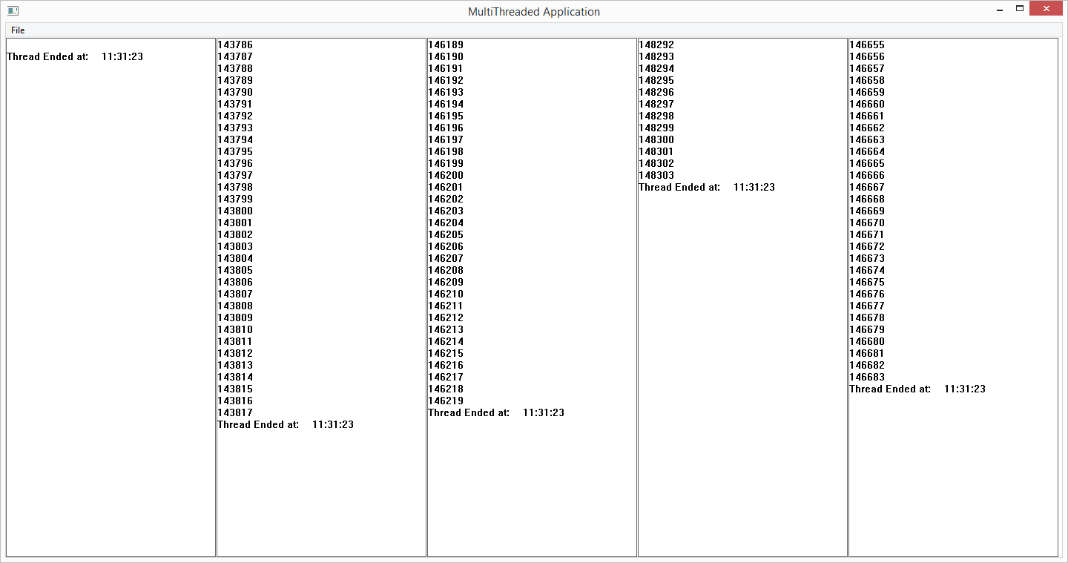
Four Counting Threads for 30 Seconds

Slide 4
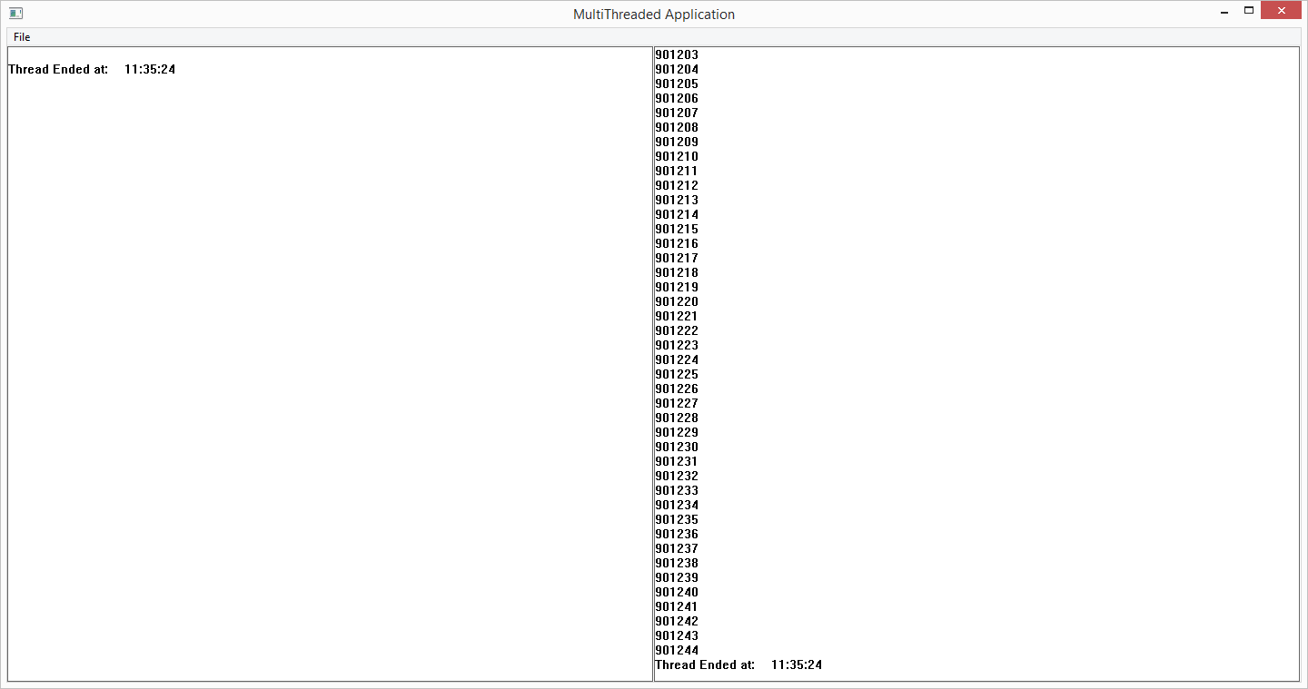
One Counting Thread for 30 Seconds

Slide 5
Deadlock
Definition: Permanent blocking of a set of processes that either compete for system resources or communicate with each other
To what extent can we prevent deadlock?
Notes:
Deadlock can be defined as the permanent blocking of a set of processes that either compete for system resources or communicate with each other. A set of processes is deadlocked when each process in the set is blocked awaiting an event (typically the freeing up of some requested resource) that can only be triggered by another blocked process in the set. Deadlock is permanent because none of the events is ever triggered. Unlike other problems in concurrent process management, there is no efficient solution in the general case.
Deadlock can be prevented to a certain extent; however, we cannot prevent deadlock in a concurrent environment. Possible solutions are having only one process, or a very rigid system of resource allocation, which is against performance.

Slide 6
Indefinite Postponement
Not deadlock, but wait for an event that might never occur or might occur unpredictably far in the future
Also called starvation
Two distinct situations:
Process temporarily blocked - starvation
Process continuously executing the same sequence of code - livelock

Slide 7
Important
To prevent deadlock, use good programming skills!
Do not:
request a resource and forget to release it
release a resource that was never requested
hold a resource for a long time without needing it
use a resource without requesting it first (or after releasing it)
However, even if the code is correct, deadlock may still occur because the concurrent execution
Example?
E.g., when different resources are managed by different semaphores and when processes need to use more than one resource at a time

Slide 8
Consequences of Concurency
Deadlock, starvation and livelock are consequences of concurrent programming
We will discuss:
Examples
Conditions for deadlock
Solutions implemented in modern operating systems

Slide 9
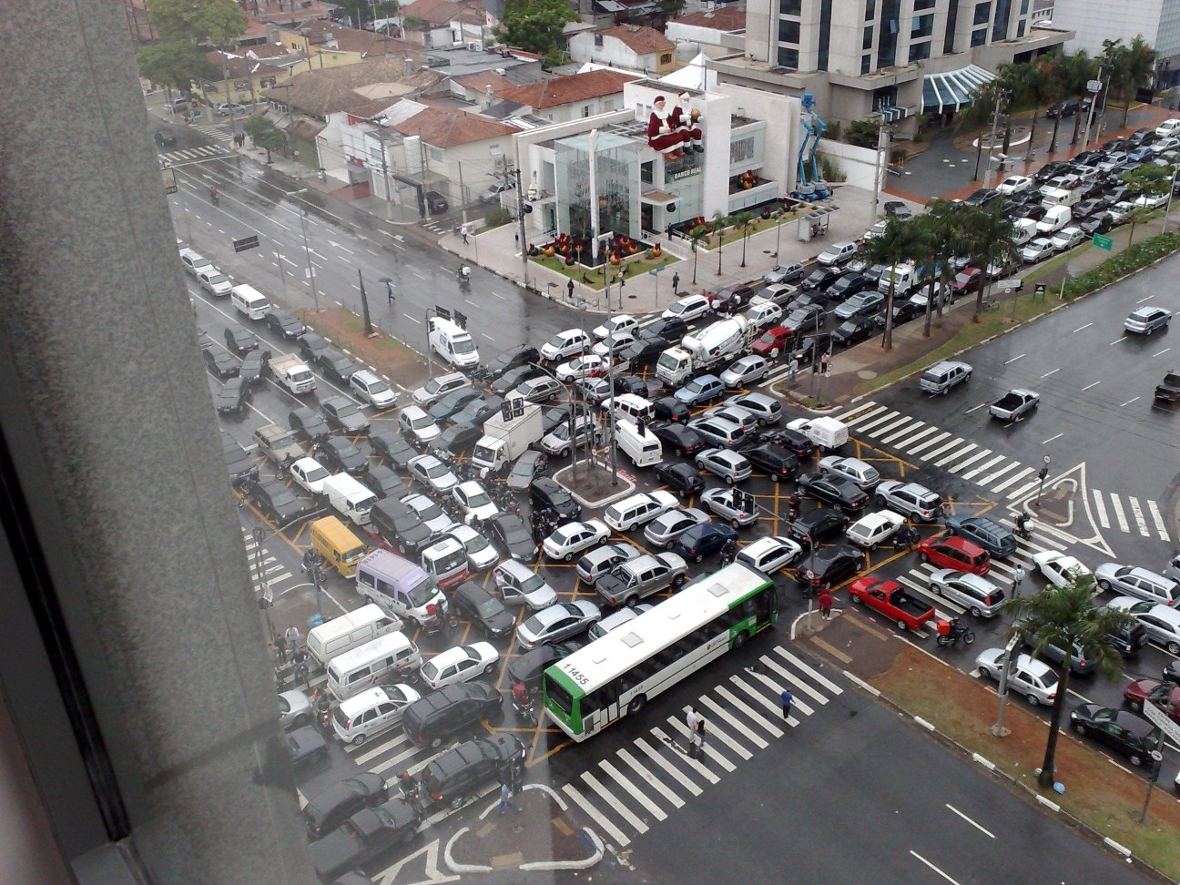
Deadlock: Example
Image courtesy of: http://mcs109.bu.edu/site/files/deadlock/citydeadlock.jpg

Slide 10
Notes:
All deadlocks involve conflicting needs for resources by two or more processes. A common example is the traffic deadlock. Figure 6.1a shows a situation in which four cars have arrived at a four-way stop intersection at approximately the same time. The four quadrants of the intersection are the resources over which control is needed. In particular, if all four cars wish to go straight through the intersection, the resource requirements are as follows:
• Car 1, traveling north, needs quadrants a and b.
• Car 2 needs quadrants b and c.
• Car 3 needs quadrants c and d.
• Car 4 needs quadrants d and a.
The rule of the road in the United States is that a car at a four-way stop should defer to a car immediately to its right. This rule works if there are only two or three cars at the intersection. For example, if only the northbound and westbound cars arrive at the intersection, the northbound car will wait and the westbound car proceeds. However, if all four cars arrive at about the same time, each will refrain from entering the intersection, this causes a potential deadlock. The deadlock is only potential, not actual, because the necessary resources are available for any of the cars to proceed. If one car eventually does proceed, it can do so.
However, if all four cars ignore the rules and proceed (cautiously) into the
intersection at the same time, then each car seizes one resource (one quadrant) but
cannot proceed because the required second resource has already been seized by
another car. This is an actual deadlock.

Slide 11
Notes:
Let us now look at a depiction of deadlock involving processes and computer resources. Figure 6.2 (based on one in [BACO03]), which we refer to as a joint progress diagram , illustrates the progress of two processes competing for two resources. Each process needs exclusive use of both resources for a certain period of time.
In Figure 6.2 , the x -axis represents progress in the execution of P and the y –axis represents progress in the execution of Q. The joint progress of the two processes is therefore represented by a path that progresses from the origin in a northeasterly direction. For a uniprocessor system, only one process at a time may execute, and the path consists of alternating horizontal and vertical segments, with a horizontal segment representing a period when P executes and Q waits and a vertical segment representing a period when Q executes and P waits. The figure indicates areas in which both P and Q require resource A (upward slanted lines); both P and Q require resource B (downward slanted lines); and both P and Q require both resources. Because we assume that each process requires exclusive control of any resource, these are all forbidden regions; that is, it is impossible for any path representing the
joint execution progress of P and Q to enter these regions.
The figure shows six different execution paths. These can be summarized as
follows:
1. Q acquires B and then A and then releases B and A. When P resumes execution,
it will be able to acquire both resources.
2. Q acquires B and then A. P executes and blocks on a request for A. Q releases
B and A. When P resumes execution, it will be able to acquire both resources.
3. Q acquires B and then P acquires A. Deadlock is inevitable, because as execution
proceeds, Q will block on A and P will block on B.
4. P acquires A and then Q acquires B. Deadlock is inevitable, because as execution
proceeds, Q will block on A and P will block on B.
5. P acquires A and then B. Q executes and blocks on a request for B. P releases
A and B. When Q resumes execution, it will be able to acquire both resources.
6. P acquires A and then B and then releases A and B. When Q resumes execution,
it will be able to acquire both resources.
The gray-shaded area of Figure 6.2 , which can be referred to as a fatal region , applies to the commentary on paths 3 and 4. If an execution path enters this fatal region, then deadlock is inevitable. Note that the existence of a fatal region depends on the logic of the two processes. However, deadlock is only inevitable if the joint progress of the two processes creates a path that enters the fatal region.

Slide 12
Notes:
Whether or not deadlock occurs depends on both the dynamics of the execution and on the details of the application.
This situation is reflected in Figure 6.3 . Some thought should convince you that regardless of the relative timing of the two processes, deadlock cannot occur.
As shown, the joint progress diagram can be used to record the execution history of two processes that share resources. In cases where more than two processes may compete for the same resource, a higher-dimensional diagram would be required. The principles concerning fatal regions and deadlock would remain the same.

Slide 13
Dining Philosophers Problem

Slide 14
Resource Categories
Reusable
Can be safely used by only one process at a time and is not depleted by that use
Processors, I/O channels, main and secondary memory, devices, and data structures such as files, databases, and semaphores
Consumable
Can be created (produced) and destroyed (consumed)
Interrupts, signals, messages, and information
Data in I/O buffers
Notes:
Two general categories of resources can be distinguished: reusable and consumable. A reusable resource is one that can be safely used by only one process at a time and is not depleted by that use. Processes obtain resource units that they later release for reuse by other processes. Examples of reusable resources include processors; I/O channels; main and secondary memory; devices; and data structures such as files, databases, and semaphores.
A consumable resource is one that can be created (produced) and destroyed (consumed). Examples of consumable resources are interrupts, signals, messages, and information in I/O buffers.

Slide 15
Reusable Resources: Example 1
Figure 6.4
Example of Two Processes Competing for Reusable Resources
Notes:
As an example of deadlock involving reusable resources, consider two processes that compete for exclusive access to a disk file D and a tape drive T. The programs engage in the operations depicted in Figure 6.4 . Deadlock occurs if each process holds one resource and requests the other. For example, deadlock occurs if the multiprogramming system interleaves the execution of the two processes as follows:
p 0 p 1 q 0 q 1 p 2 q 2
It may appear that this is a programming error rather than a problem for the OS designer. However, we have seen that concurrent program design is challenging. Such deadlocks do occur, and the cause is often embedded in complex program logic, making detection difficult. One strategy for dealing with such a deadlock is to impose system design constraints concerning the order in which resources can be requested.

Slide 16
Reusable Resources: Example 2
Memory request: Space is available for allocation of 200Kbytes, and the following sequence of events occur:
Deadlock occurs if both processes progress to their second request
P1
P2
. . .
. . .
Request 80 Kbytes;
Request 70 Kbytes;
. . .
. . .
Request 60 Kbytes;
Request 80 Kbytes;
Notes:
Another example of deadlock with a reusable resource has to do with requests for main memory. Suppose the space available for allocation is 200 Kbytes, and the following sequence of requests occurs: (see diagram)
Deadlock occurs if both processes progress to their second request. If the amount of memory to be requested is not known ahead of time, it is difficult to deal with this type of deadlock by means of system design constraints. The best way to deal with this particular problem is, in effect, to eliminate the possibility by using virtual memory, which is discussed in Chapter 8 .

Slide 17
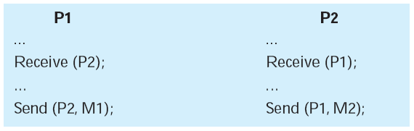
Consumable Resources: Example
Consider a pair of processes, in which each process attempts to receive a message from the other process and then send a message to the other process:
Deadlock occurs if the Receive is blocking
Notes:
As an example of deadlock involving consumable resources, consider the following pair of processes, in which each process attempts to receive a message
from the other process and then send a message to the other process: (see diagram)
Deadlock occurs if the Receive is blocking (i.e., the receiving process is blocked until the message is received). Once again, a design error is the cause of the deadlock. Such errors may be quite subtle and difficult to detect. Furthermore, it may take a rare combination of events to cause the deadlock; thus a program could be in use for a considerable period of time, even years, before the deadlock actually occurs.

Slide 18
Conditions for Deadlock (1)
Coffman, Elphick and Shoshani (1971)
Proved that four conditions are necessary for deadlock to exist
http://www.ccs.neu.edu/home/pjd/cs7600-s10/Tuesday_January_26_01/p67-coffman.pdf
First three conditions don’t end in deadlock, but can generate a “circular wait”
They are necessary but not sufficient conditions for deadlock

Slide 19
Conditions for Deadlock (2)
Mutual Exclusion
only one process may use a resource at a time (desirable)
Hold-and-Wait
a process may hold allocated resources while awaiting assignment of others (desirable)
No Pre-emption
no resource can be forcibly removed from a process holding it (desirable)
Circular Wait
a closed chain of processes exists, such that each process holds at least one resource needed by the next process in the chain
Notes:
Three conditions of policy must be present for a deadlock to be possible:
1. Mutual exclusion . Only one process may use a resource at a time. No process may access a resource unit that has been allocated to another process.
2. Hold and wait . A process may hold allocated resources while awaiting assignment of other resources.
3. No preemption . No resource can be forcibly removed from a process holding it.
In many ways these conditions are quite desirable. For example, mutual exclusion is needed to ensure consistency of results and the integrity of a database. Similarly, preemption should not be done arbitrarily. For example, when data resources are involved, preemption must be supported by a rollback recovery mechanism, which restores a process and its resources to a suitable previous state from which the process can eventually repeat its actions.
The first three conditions are necessary but not sufficient for a deadlock to exist. For deadlock to actually take place, a fourth condition is required:
4. Circular wait . A closed chain of processes exists, such that each process holds at least one resource needed by the next process in the chain (e.g., Figure 6.5c
and Figure 6.6 ).
The fourth condition is, actually, a potential consequence of the first three. That is, given that the first three conditions exist, a sequence of events may occur that lead to an unresolvable circular wait. The unresolvable circular wait is in fact the definition of deadlock. The circular wait listed as condition 4 is unresolvable because the first three conditions hold. Thus, the four conditions, taken together, constitute necessary and sufficient conditions for deadlock.

Slide 20
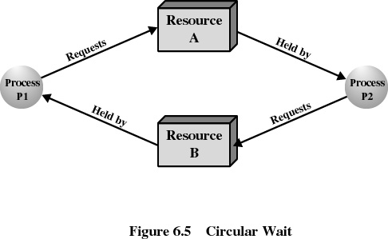
Conditions for Deadlock (3)
Circular wait
Condition for deadlock
Consequence of the first three conditions
https://www.youtube.com/watch?v=myomEBjnIDw

Slide 21
Deadlock Solutions
Deadlock Prevention
Remove any possibility of deadlock
Adopt a OS policy that eliminates one of the deadlock conditions
Deadlock Avoidance
Identify an approaching deadlock situation and solve it before occur
Based on the current state of execution, make dynamic changes on resource allocation
Deadlock Detection
Detect deadlock
Deadlock Recovery
Implement a policy of process recovery from deadlock

Slide 22
Deadlock Prevention Strategy
Design a system in such a way that the possibility of deadlock is excluded
Is this possible?
Two main methods:
Indirect
prevent the occurrence of one of the three necessary conditions
Direct
prevent the occurrence of a circular wait
Notes:
The strategy of deadlock prevention is, simply put, to design a system in such a way that the possibility of deadlock is excluded. We can view deadlock prevention methods as falling into two classes. An indirect method of deadlock prevention is to prevent the occurrence of one of the three necessary conditions listed previously (items 1 through 3). A direct method of deadlock prevention is to prevent the occurrence of a circular wait (item 4).

Slide 23
Deadlock Prevention
Mutual exclusion
Mutual exclusion is removed
Hold-and-wait
A process requests all of its required resources at one time
No preemption
If a process holding certain resources is denied a further request, that process must release its original resources
Notes:
Mutual Exclusion
In general, the first of the four listed conditions cannot be disallowed. If access to a resource requires mutual exclusion, then mutual exclusion must be supported by the OS. Some resources, such as files, may allow multiple accesses for reads but only exclusive access for writes. Even in this case, deadlock can occur if more than one process requires write permission.
Hold and Wait
The hold-and-wait condition can be prevented by requiring that a process request all of its required resources at one time and blocking the process until all requests can be granted simultaneously. This approach is inefficient in two ways. First, a process may be held up for a long time waiting for all of its resource requests to be filled, when in fact it could have proceeded with only some of the resources. Second, resources allocated to a process may remain unused for a considerable period, during which time they are denied to other processes. Another problem is that a process may not know in advance all of the resources that it will require.
There is also the practical problem created by the use of modular programming or a multithreaded structure for an application. An application would need to be aware of all resources that will be requested at all levels or in all modules to make the simultaneous request.
No Preemption
This condition can be prevented in several ways. First, if a process holding certain resources is denied a further request, that process must release its original resources and, if necessary, request them again together with the additional resource. Alternatively, if a process requests a resource that is currently held by another process, the OS may preempt the second process and require it to release its resources. This latter scheme would prevent deadlock only if no two processes possessed the same priority.
This approach is practical only when applied to resources whose state can be easily saved and restored later, as is the case with a processor.
Circular Wait
The circular-wait condition can be prevented by defining a linear ordering of resource types. If a process has been allocated resources of type R , then it may subsequently request only those resources of types following R in the ordering. To see that this strategy works, let us associate an index with each resource type. Then resource R i precedes R j in the ordering if i < j . Now suppose that two processes, A and B, are deadlocked because A has acquired R _{i} and requested R _{j} , and B has acquired R _{j} and requested R _{i} . This condition is impossible because it implies i < j and j < i .
As with hold-and-wait prevention, circular-wait prevention may be inefficient, slowing down processes and denying resource access unnecessarily.

Slide 24
Deadlock Prevention (2)
Circular wait
Prevented by defining a linear ordering of resource types
Modern operating systems don’t use linear ordering because of serious limitations
Notes:
Systems that enforce a linear ordering of resources have limitations
Application portability
Resources cannot be added or eliminated easily

Slide 25
Deadlock Avoidance
A decision is made dynamically whether the current resource allocation request will, if granted, potentially lead to a deadlock
Requires knowledge of future process requests:
Probabilistic approach
Notes:
An approach to solving the deadlock problem that differs subtly from deadlock prevention is deadlock avoidance. In deadlock prevention , we constrain resource requests to prevent at least one of the four conditions of deadlock. This is either done indirectly, by preventing one of the three necessary policy conditions (mutual exclusion, hold and wait, no preemption), or directly, by preventing circular wait. This leads to inefficient use of resources and inefficient execution of processes. Deadlock avoidance , on the other hand, allows the three necessary conditions but makes judicious choices to assure that the deadlock point is never reached. As such, avoidance allows more concurrency than prevention. With deadlock avoidance, a decision is made dynamically whether the current resource allocation request will, if granted, potentially lead to a deadlock. Deadlock avoidance thus requires knowledge
of future process resource requests.

Slide 26
Two Approaches to Deadlock Avoidance
Do not start a process if its demands might lead to deadlock.
Do not grant an incremental resource request to a process if this allocation might lead to deadlock.

Slide 27

Resource Allocation Denial
Banker’s algorithm (Dijkstra)
State of the system reflects the current allocation of resources to processes
Safe state is one in which there is at least one sequence of resource allocations to processes that does not result in a deadlock
Unsafe state is a state that is not safe
Notes:
The strategy of resource allocation denial, referred to as the banker’s algorithm, was first proposed in [DIJK65]. Let us begin by defining the concepts of state and safe state. Consider a system with a fixed number of processes and a fixed number of resources. At any time a process may have zero or more resources allocated to it. The state of the system reflects the current allocation of resources to processes. Thus, the state consists of the two vectors, Resource and Available, and the two matrices, Claim and Allocation, defined earlier. A safe state is one in which there is at least one sequence of resource allocations to processes that does not result in a deadlock (i.e., all of the processes can be run to completion). An unsafe state is, of course, a state that is not safe.

Slide 28
Banker’s Algorithm
A matrix solution
Mutual exclusion, hold-and-wait and no preemption are allowed
Processes request resources, but the system grants only requests that result is safe state
The system is maintain in a safe state
safe state is where there is at least one sequence that does not result in deadlock

Slide 29
Figure 6.7 Determination of a Safe State
Notes:
The following example illustrates these concepts. Figure 6.7a shows the state of a system consisting of four processes and three resources. The total amount of resources R1, R2, and R3 are 9, 3, and 6 units, respectively. In the current state allocations have been made to the four processes, leaving 1 unit of R2 and 1 unit of R3 available. Is this a safe state? To answer this question, we ask an intermediate question: Can any of the four processes be run to completion with the resources available? That is, can the difference between the maximum requirement and current allocation for any process be met with the available resources? In terms of the matrices and vectors introduced earlier, the condition to be met
for process i is:
C_{ij} - A_{ij} … V_{j}, for all j

Slide 30
Figure 6.7 Determination of a Safe State
Notes:
Clearly, this is not possible for P1, which has only 1 unit of R1 and requires 2 more units of R1, 2 units of R2, and 2 units of R3. However, by assigning one unit of R3 to process P2, P2 has its maximum required resources allocated and can run to completion. Let us assume that this is accomplished. When P2 completes, its resources can be returned to the pool of available resources. The resulting state is shown in Figure 6.7b . Now we can ask again if any of the remaining processes can be completed. In this case, each of the remaining processes could be completed.

Slide 31
Figure 6.7 Determination of a Safe State
Notes:
Suppose we choose P1, allocate the required resources, complete P1, and return all of P1’s resources to the available pool. We are left in the state shown in Figure 6.7c .

Slide 32
(d) P3 runs to completion
Figure 6.7 Determination of a Safe State
Notes:
Next, we can complete P3, resulting in the state of Figure 6.7d . Finally, we can complete P4. At this point, all of the processes have been run to completion. Thus, the state defined by Figure 6.7a is a safe state.
These concepts suggest the following deadlock avoidance strategy, which ensures that the system of processes and resources is always in a safe state. When a process makes a request for a set of resources, assume that the request is granted, update the system state accordingly, and then determine if the result is a safe state. If so, grant the request and, if not, block the process until it is safe to grant the request.

Slide 33
Figure 6.8 Determination of an Unsafe State
Notes:
Consider the state defined in Figure 6.8a . Suppose P2 makes a request for one additional unit of R1 and one additional unit of R3. If we assume the request is granted, then the resulting state is that of Figure 6.7a . We have already seen that this is a safe state; therefore, it is safe to grant the request. Now let us return to the state of Figure 6.8a and suppose that P1 makes the request for one additional unit each of R1 and R3; if we assume that the request is granted, we are left in the state of Figure 6.8b . Is this a safe state? The answer is no, because each process will need at least one additional unit of R1, and there are none available. Thus, on the basis of deadlock avoidance, the request by P1 should be denied and P1 should be blocked.
It is important to point out that Figure 6.8b is not a deadlocked state. It merely has the potential for deadlock. It is possible, for example, that if P1 were run from this state it would subsequently release one unit of R1 and one unit of R3 prior to needing these resources again. If that happened, the system would return to a safe state. Thus, the deadlock avoidance strategy does not predict deadlock with certainty; it merely anticipates the possibility of deadlock and assures that there is never such a possibility.

Slide 34
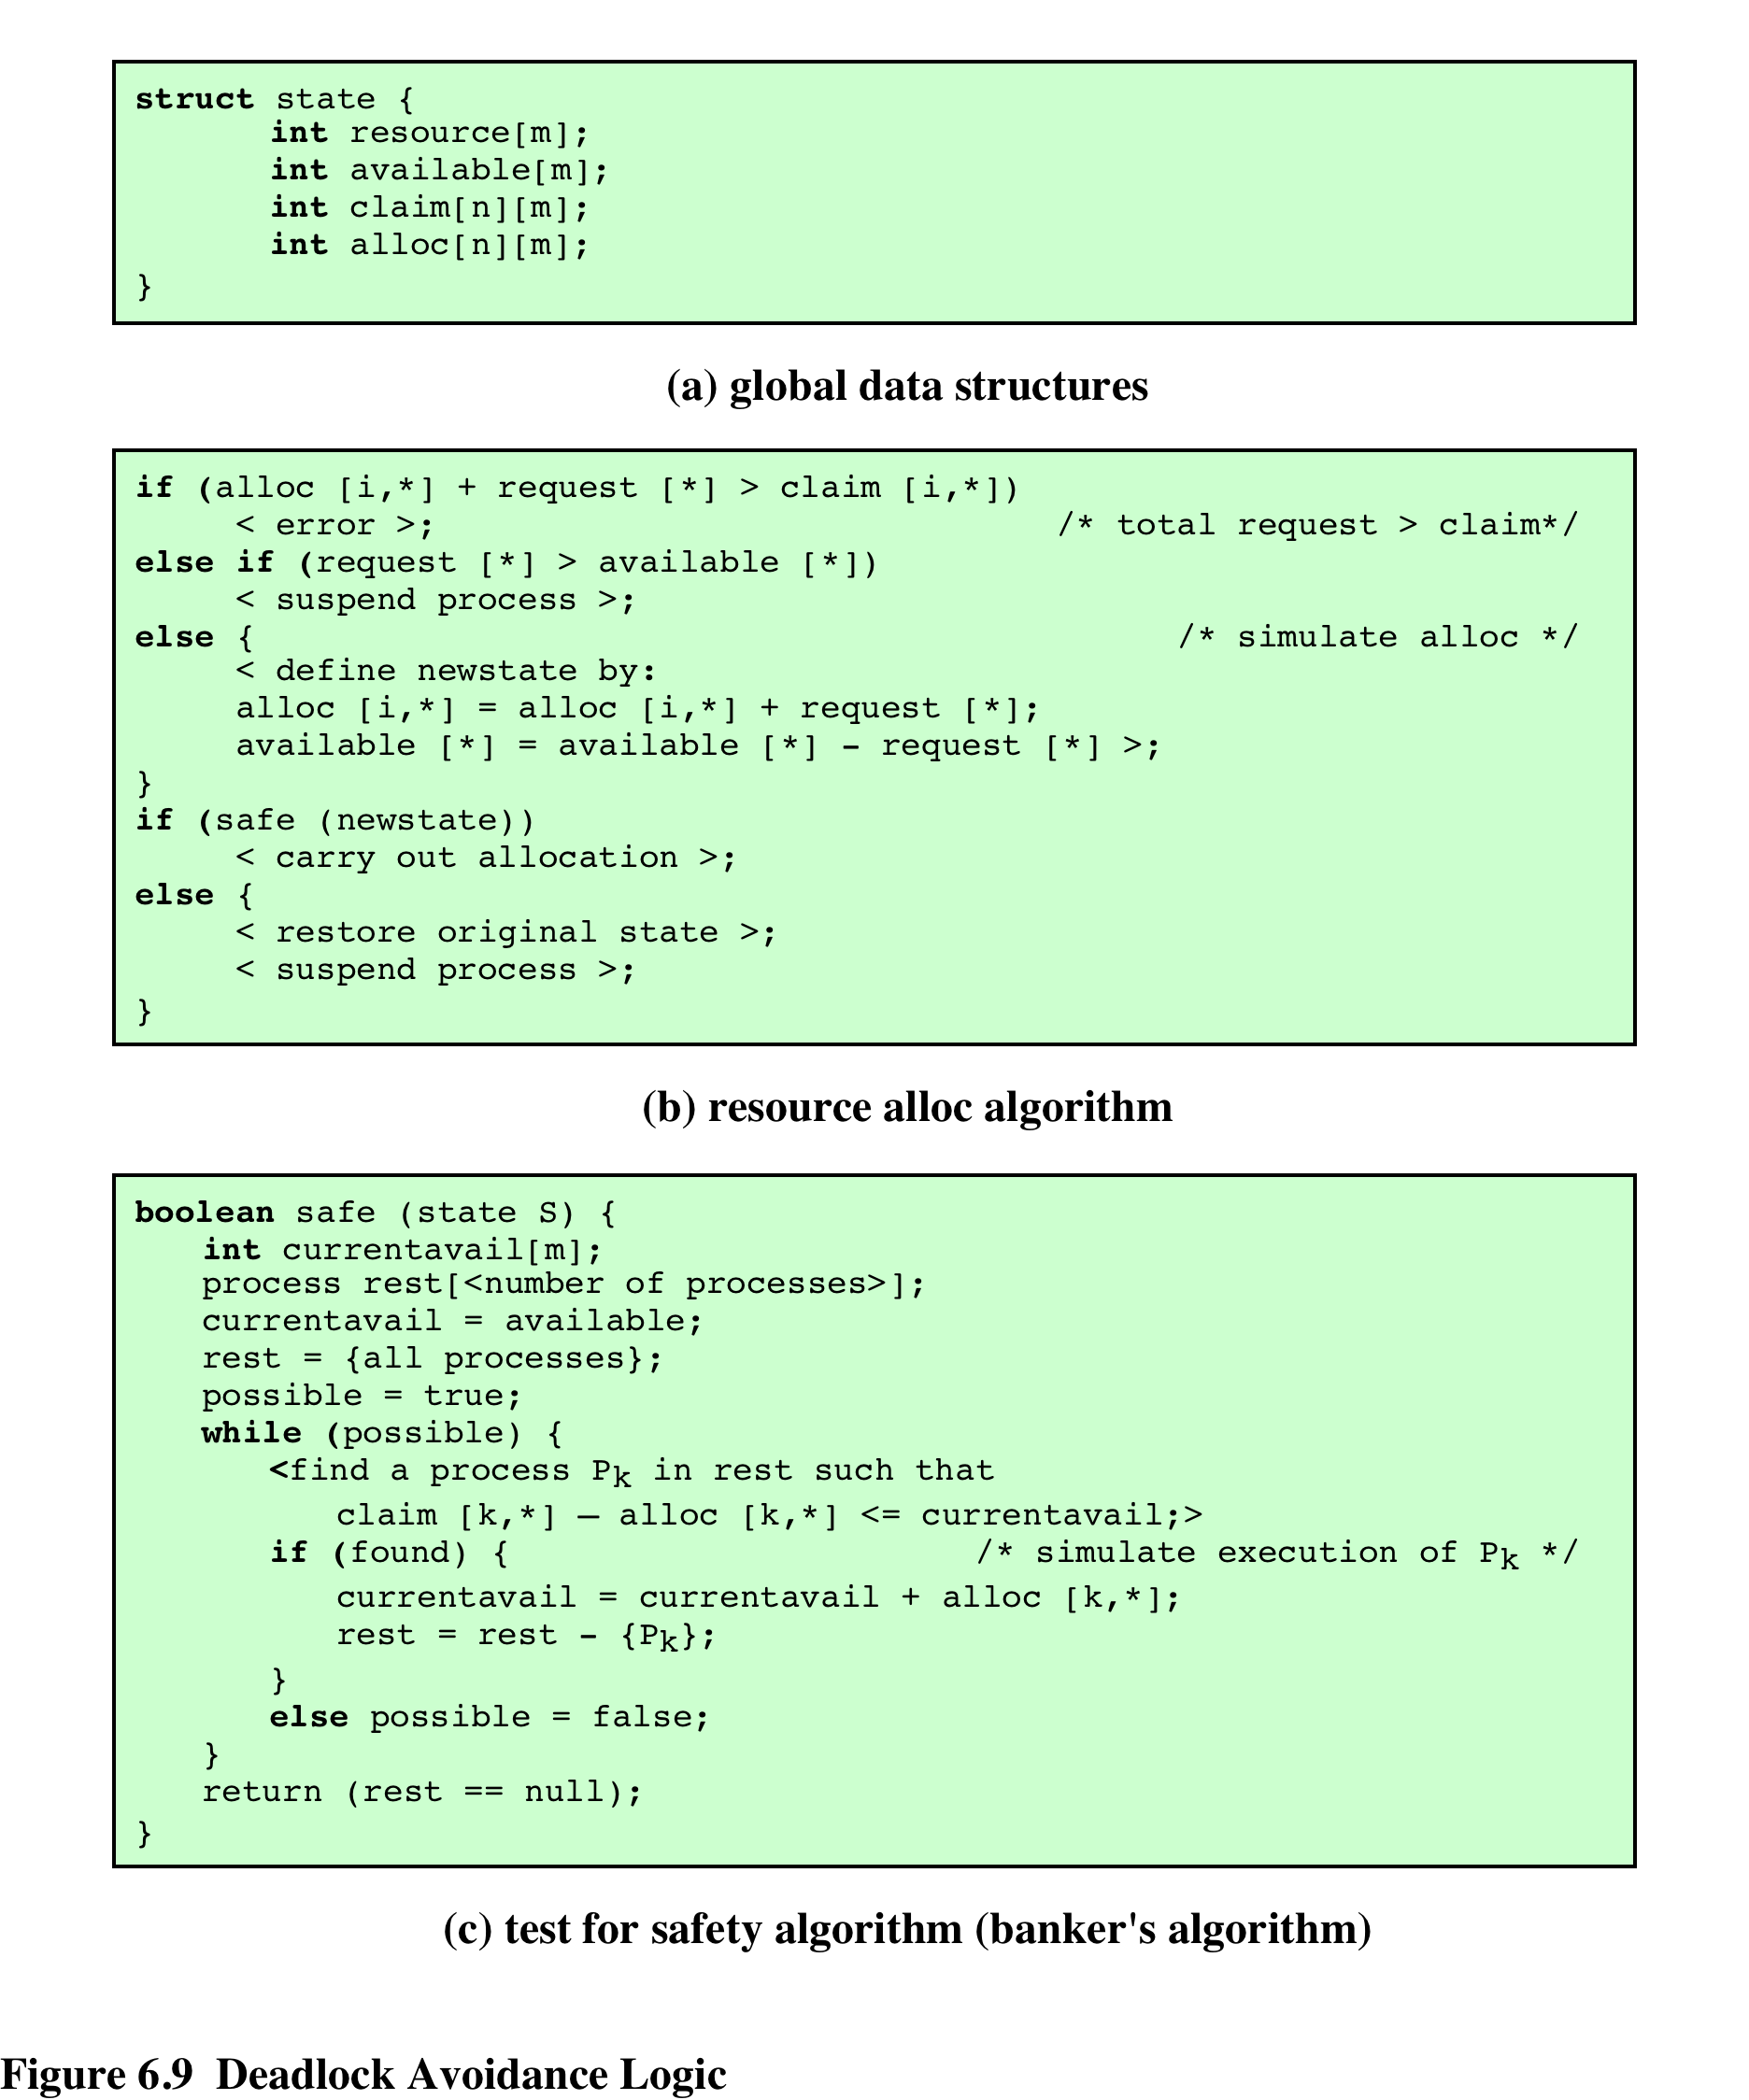
Figure 6.9
Deadlock Avoidance Logic
Notes:
Figure 6.9 gives an abstract version of the deadlock avoidance logic. The main algorithm is shown in part (b). With the state of the system defined by the data structure state , request[*] is a vector defining the resources requested by process i . First, a check is made to assure that the request does not exceed the original claim of the process. If the request is valid, the next step is to determine if it is possible to fulfill the request (i.e., there are sufficient resources available). If it is not possible, then the process is suspended. If it is possible, the final step is to
determine if it is safe to fulfill the request. To do this, the resources are tentatively assigned to process i to form newstate .
Then a test for safety is made using the algorithm in Figure 6.9c.

Slide 35
Deadlock Avoidance Advantages
It is not necessary to preempt and rollback processes, as in deadlock detection
It is less restrictive than deadlock prevention
Notes:
Deadlock avoidance has the advantage that it is not necessary to preempt and
rollback processes, as in deadlock detection, and is less restrictive than deadlock
prevention.

Slide 36
Disadvantages of the Banker’s Algorithm
The maximum resource requirement must be stated in advance by each process.
Processes under consideration must be independent; no synchronization requirements.
There must be a fixed number of resources to allocate.
No process may exit while holding resources
The number of processes should be fix.
Because of these limitations, the banker’s algorithm is not implemented in modern operating systems.

Slide 37
Deadlock Detection
Deadlock detection algorithms focus on determining if a circular wait occurred
It can add a significant runtime overhead

Slide 38
Deadlock Detection Algorithms
A check for deadlock can be made as frequently as each resource request or, less frequently, depending on how likely it is for a deadlock to occur
Advantages:
it leads to early detection
the algorithm is relatively simple
Disadvantage
frequent checks consume considerable processor time
Notes:
A check for deadlock can be made as frequently as each resource request or, less frequently, depending on how likely it is for a deadlock to occur. Checking at each resource request has two advantages: It leads to early detection, and the algorithm is relatively simple because it is based on incremental changes to the state of the system. On the other hand, such frequent checks consume considerable processor time.

Slide 39
Notes:
We can use Figure 6.10 to illustrate the deadlock detection algorithm. The
algorithm proceeds as follows:
1. Mark P4, because P4 has no allocated resources.
2. Set W = (0 0 0 0 1).
3. The request of process P3 is less than or equal to W, so mark P3 and set W=W + (0 0 0 1 0) = (0 0 0 1 1).
4. No other unmarked process has a row in Q that is less than or equal to W.
Therefore, terminate the algorithm.
The algorithm concludes with P1 and P2 unmarked, indicating that these processes are deadlocked.

Slide 40
Deadlock Recovery
Once the deadlock was detected, it must be broken by removing one or more of the four conditions.
Usually, several processes will lose some work.
Recovery is complicated:
The system should bring processes to a previous point and restart them again.

Slide 41
Strategies once Deadlock Detected
Abort all deadlocked processes
Back up each deadlocked process to some previously defined checkpoint, and restart all process
original deadlock may occur
Successively abort deadlocked processes until deadlock no longer exists
Successively preempt resources until deadlock no longer exists

Slide 42
Selection Criteria Deadlocked Processes
Least amount of processor time consumed so far
Least number of lines of output produced so far
Most estimated time remaining
Least total resources allocated so far
Lowest priority

Slide 43
Conclusion
Deadlock is a consequence of concurrent programming
Permanent
No efficient solution

Slide 44
Deadlock in Modern Operating Systems (1)
Algorithms to prevent, avoid, detect, and recover from deadlock are expensive
Operating systems are designed such that functions that are native to OS would rarely result in deadlock
Operating systems use techniques that prevent starvation: e.g., perform change of process’ priority to prevent starvation of low-priority processes
Programmers are advised to release resources even in managed languages like C# and to not leave the de-allocation to the GC (e.g., see the “using” statement in C#)

Slide 45
Deadlock in Modern Operating Systems (2)
In personal computers and workstations, deadlock is ignored or a simple deadlock prevention is implemented
Real-time operating systems require deadlock-free resource allocation
Deadlock is an important area of research

Slide 46
Summary
Principles of deadlock
Reusable/consumable resources
Resource allocation graphs
Conditions for deadlock
Deadlock prevention
Mutual exclusion
Hold and wait
No preemption
Circular wait
Deadlock avoidance
Process initiation denial
Resource allocation denial
Deadlock detection
Deadlock detection algorithm
Recovery
Notes:
Chapter 6 summary.

